Slide 1
Lecture Foundations of Artificial Intelligence Part 9 – Machine Learning 2
Torsten Zesch
Language Technology Lab
Universität Duisburg-Essen
Notes:
Willkommen zur Vorlesung Grundlagen der künstlichen Intelligenz, oder auch Wissensrepräsentation.

Slide 2
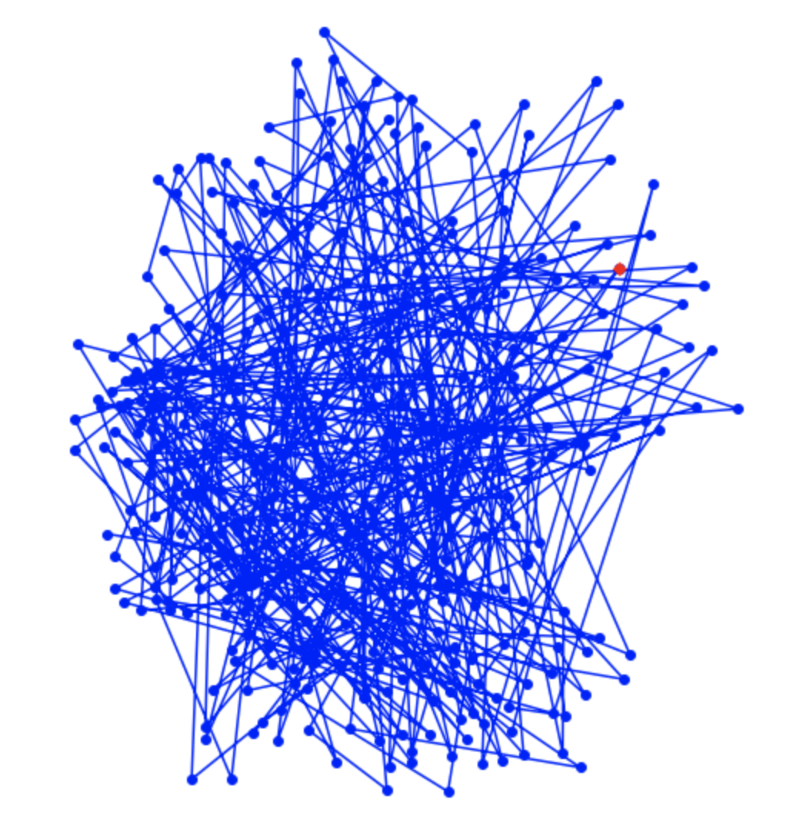

Slide 3
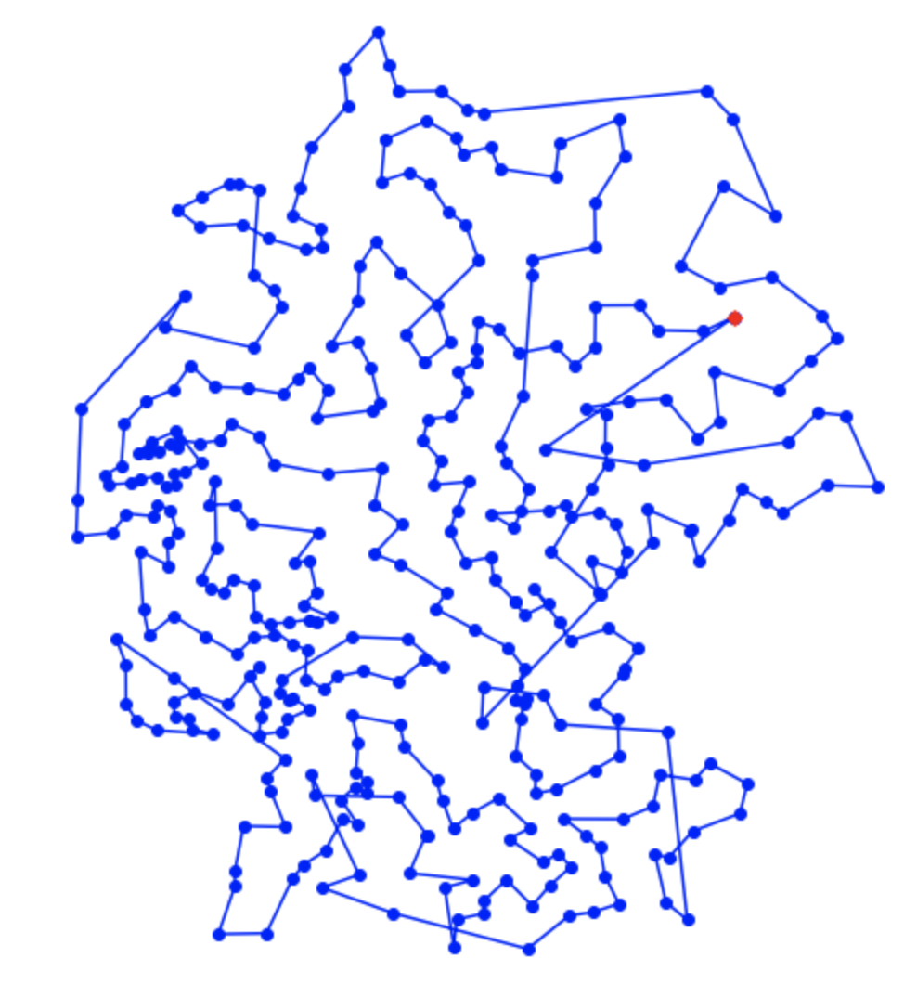

Slide 4
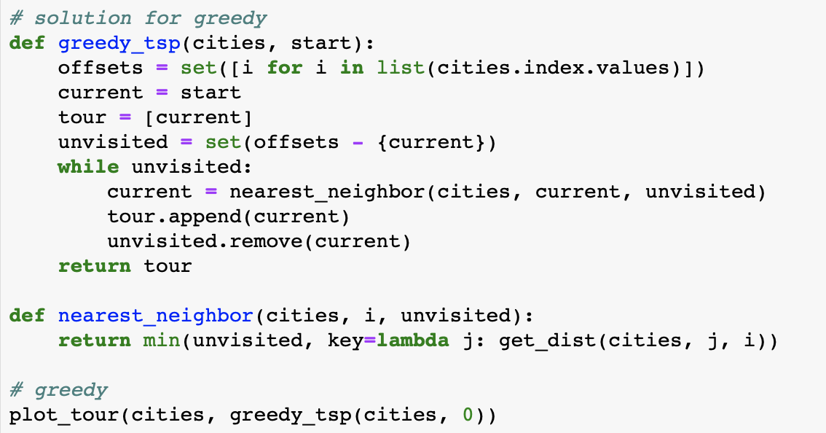

Slide 5
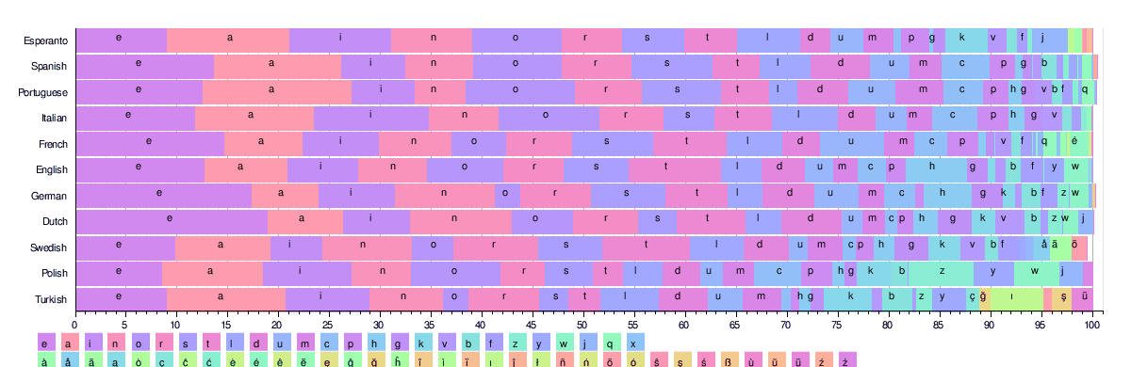
Last week: Features
Different types: binary, nominal, ordinal, numeric
Many features are highly domain- and task-specific.
Feature selection: entropy, information gain

Slide 6

Any other open questions?

Slide 7
Today
Machine Learning Algorithms
Notes:
Beispiel für Business Analytics Studenten

Slide 8
Represented knowledge
We have determined an appropriate knowledge representation for our training data.
How do we use this representation to predict the class of a new instance?

Slide 9
Decision Trees

Slide 10
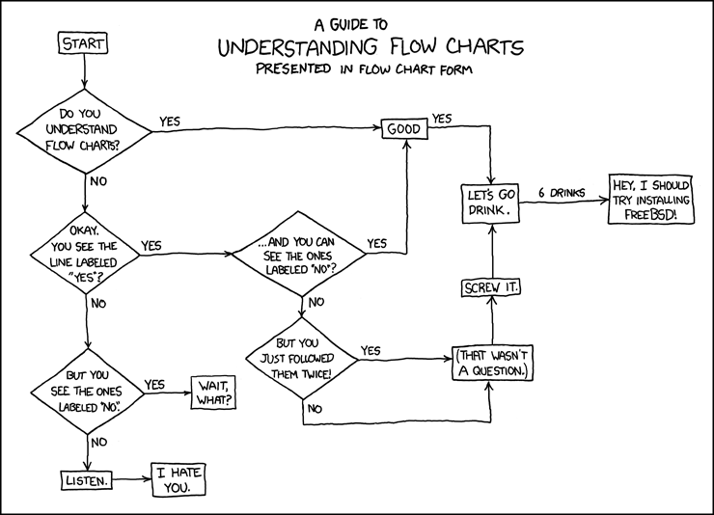
From flow charts to decision trees
https://xkcd.com/518/
Notes:
Intuitive example of an classifier.
You have all used something like that before.

Slide 11
Name gender
Andrea
Dorchadas
Tom
Brigitte
Laraine
Lumen
Jamel
Diarmid
Simone
Dafne
Lea
Lumen
Wilhelm
Noor
Dietgard
Keisuke
Notes:
Which of these names are male/female?
How do you know?

Slide 12
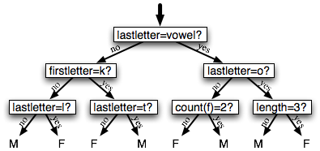
Decision trees
Flowchart that selects labels for input values
Decision nodes check feature values
Leaf nodes assign labels
Start with the root node (decision stump)
Use feature value that classifies all input best
Continue growing using most informative features
Notes:
[PLAY – Namen nennen lassen – Klassifizieren – korrekt/inkorrekt notieren, dann Accuracy/Precision/Recall ausrechnen]

Slide 13
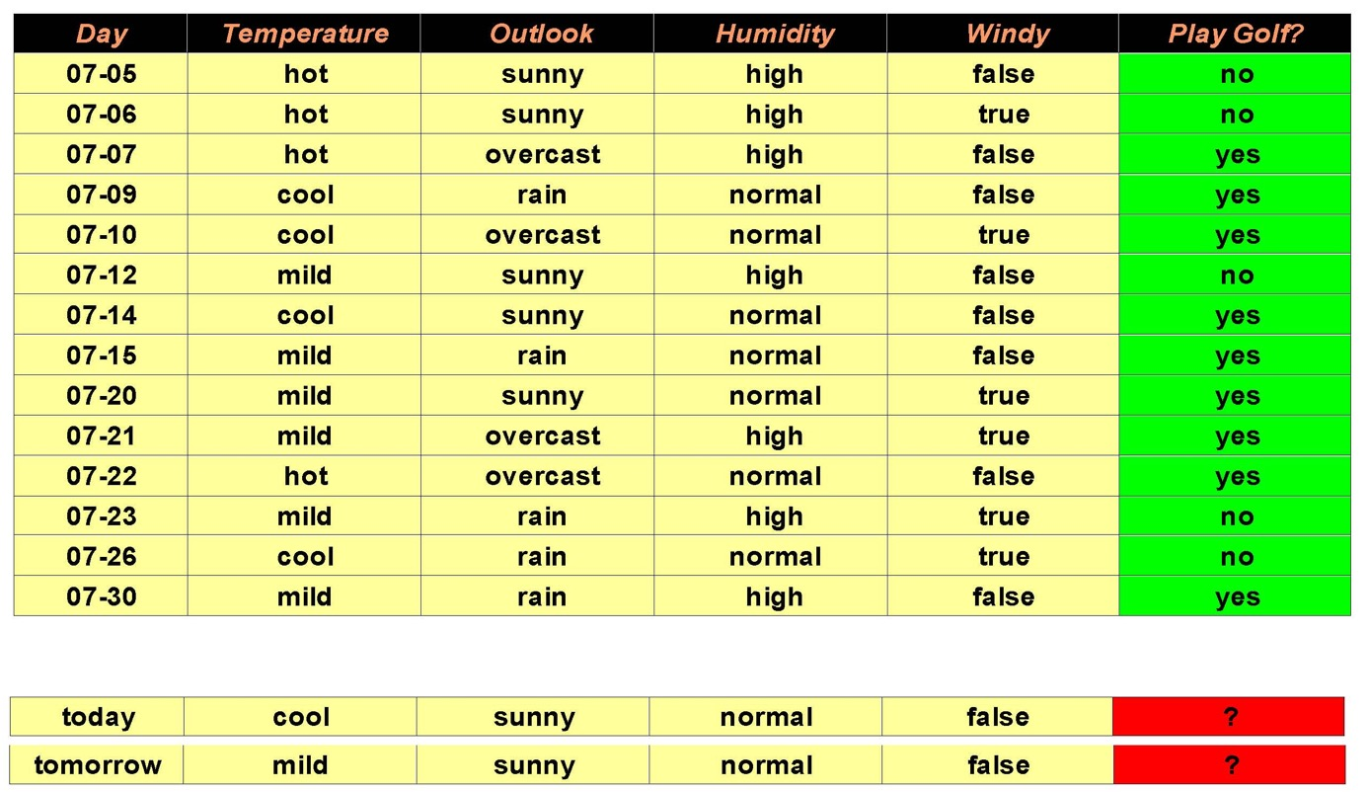
Play golf example
Notes:
Zeit nehmen und Terme noch einmal erklären: Instances, Features, Gold Label, Train/Test

Slide 14
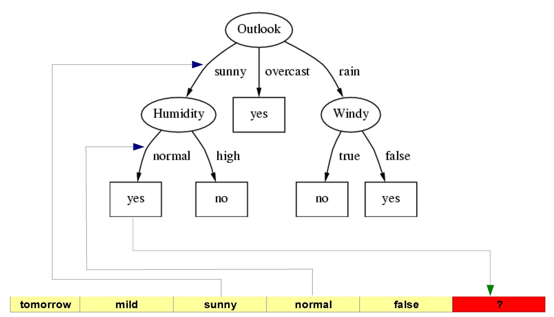
Final decision tree

Slide 15
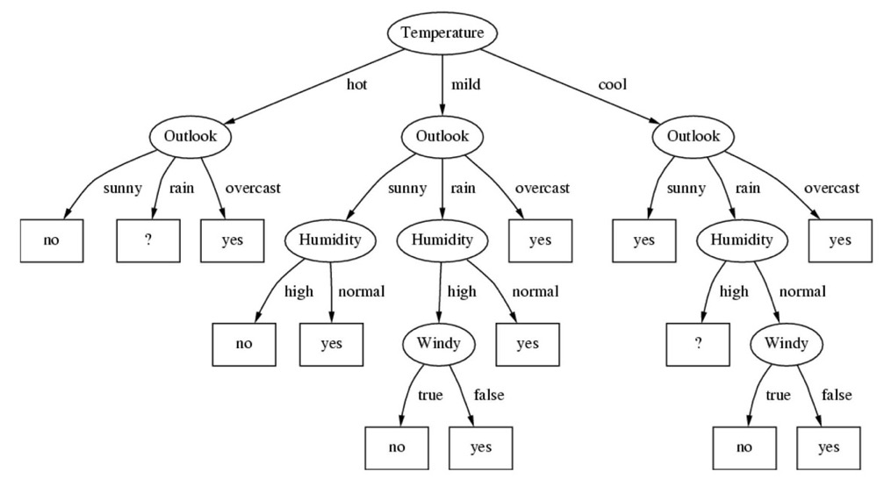
How do we find the best decision tree?
Search through all possible trees? → Too expensive.
This tree also explains all the training data. Will it generalize well to new data?
→ Determine good decision nodes based on information gain.
→ Do not overfit.
Notes:
Wichtig: Information Gain muss iterativ jedes Mal neu berechnet werden!

Slide 16
Entropy (for two classes)
S is a set of examples
P_{i} is the proportion of examples in class i
P_{j} = 1 – p_{i} is the proportion of examples in the other class j
Maximal value at equal class distribution
Interpretation:
Amount of unorderedness in the class distribution of S
Minimal value if only one class left in S

Slide 17
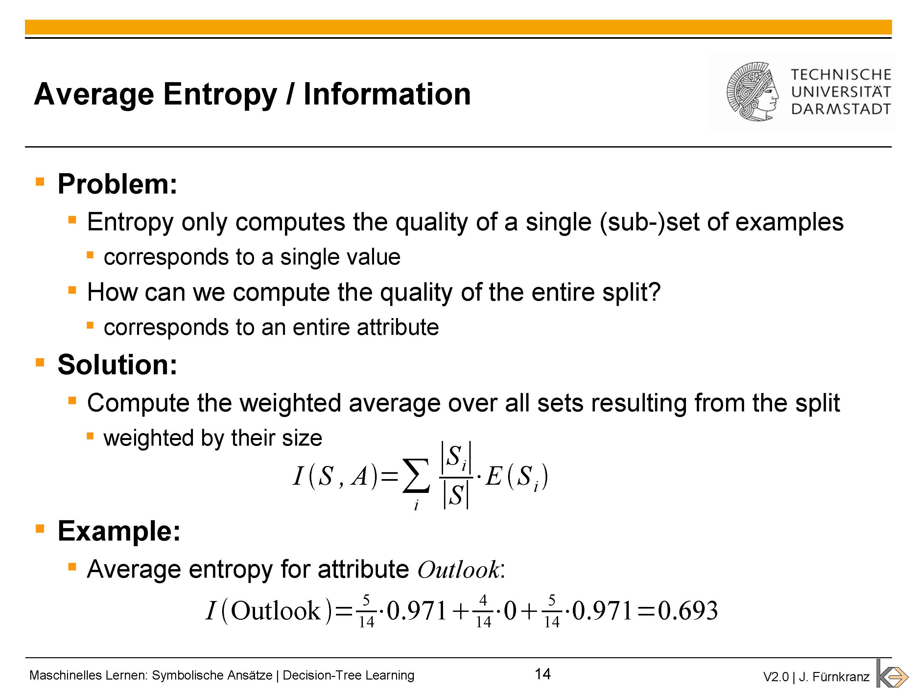
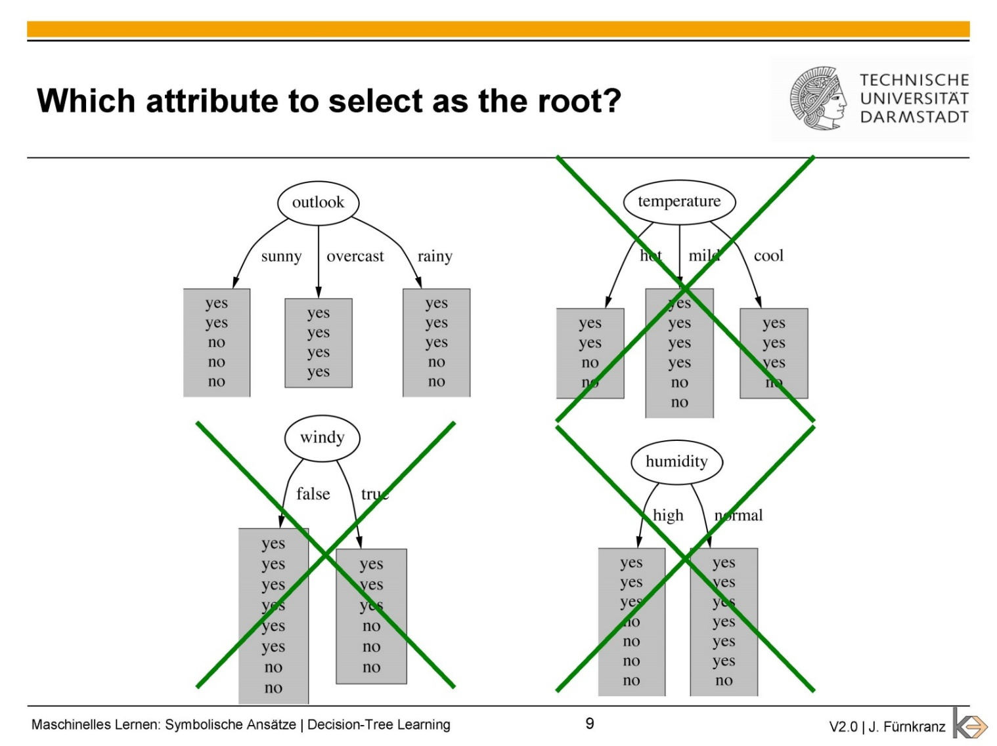
Average entropy / information
Problem:
Entropy only computes the quality of a single (sub-)set of examples
Corresponds to a single value
How can we compute the quality of the entire split?
Corresponds to an entire attribute
Solution:
Compute the weighted average over all sets resulting from the split
Weighted by their size
Example:
Average entropy for attribute Outlook:

Slide 18
Decision tree example
outlook=sunny (3 yes/2 no)
$Entropy\left(sunny\right)= −\frac{3}{5}∗\log{\frac{3}{5}} −\frac{2}{5}∗\log{\frac{2}{5}=0.97}$
outlook=overcast (4 yes/0 no)
$$Entropy\left(overcast\right)= −1∗log 1−0∗\log{0=0}$$
outlook=rainy (2 yes/3 no)
$$Entropy\left(rainy\right)= −\frac{2}{5}∗\log{\frac{2}{5}} −\frac{3}{5}∗\log{\frac{3}{5}=0.97}$$
Information(outlook) =
$\frac{5}{14}∗0.97+\frac{4}{14}∗0$+ $\frac{5}{14}∗0.97 =0.69$
log(0) is undefined
Notes:
Entropy für sunny und rainy gleich

Slide 19
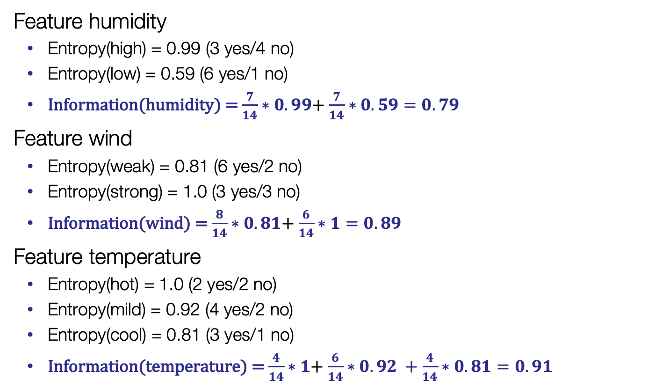
Information of features
Feature humidity
Entropy(high) = 0.99 (3 yes/4 no)
Entropy(low) = 0.59 (6 yes/1 no)
Information(humidity) = $\frac{7}{14}∗0.99$+ $\frac{7}{14}∗0.59=0.79$
Feature wind
Entropy(weak) = 0.81 (6 yes/2 no)
Entropy(strong) = 1.0 (3 yes/3 no)
Information(wind) = $\frac{8}{14}∗0.81$+ $\frac{6}{14}∗1=0.89$
Feature temperature
Entropy(hot) = 1.0 (2 yes/2 no)
Entropy(mild) = 0.92 (4 yes/2 no)
Entropy(cool) = 0.81 (3 yes/1 no)
Information(temperature) = $\frac{4}{14}∗1$+ $\frac{6}{14}∗0.92 +\frac{4}{14}∗0.81=0.91$
Notes:
nicht im Detail durchgehen, nur highlights, aber trotzdem Zeit lassen
gleiche Anzahl yes/no (strong wind) → Entropy 1
Fast nur eine Klasse (low humidity) → Entropy niedrig

Slide 20
Information Gain
Entropy(before) = 0.94 (9 yes/5 no)
InformationGain(outlook) = 0.94 – 0.69 = 0.25
InformationGain(humidity) = 0.94 – 0.79 = 0.15
InformationGain(wind) = 0.94 – 0.89 = 0.05
InformationGain(temperature) = 0.94 – 0.91 = 0.03
Select feature outlook as root node

Slide 21
ID3 algorithm
Input: instance set S, Output: decision tree T
If all instances in S belong to the same class c
add a new leaf to T and label it with c
Else
Calculate a feature evaluation measure and select the best feature f
Add node n to T with f as decision
For each value v_{i} of f
Let S_{i} = {all examples in S with f=v_{i}}
For each S_{i}
run ID3 to construct a subtree T_{i}
connect T_{i} and n with an edge
e.g. information gain
The feature evaluation measure needs to be recalculated every time for the remaining set S_{i}.
recursion step

Slide 22
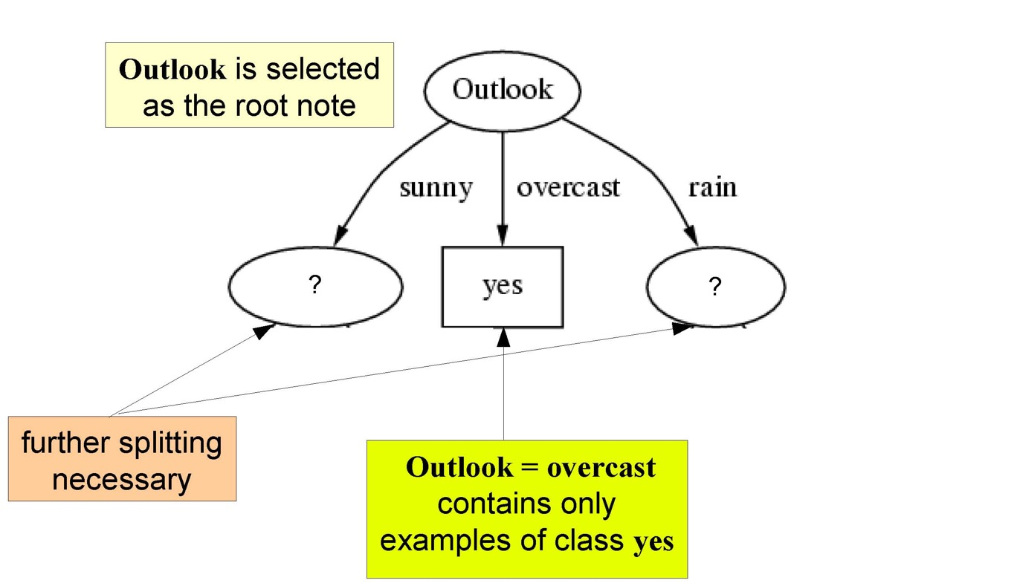
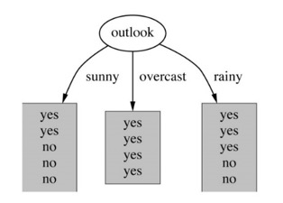
Example
Outlook is selected as root node (based on information gain)
Start recursion
All examples in S belong to class yes → add leaf node

Slide 23
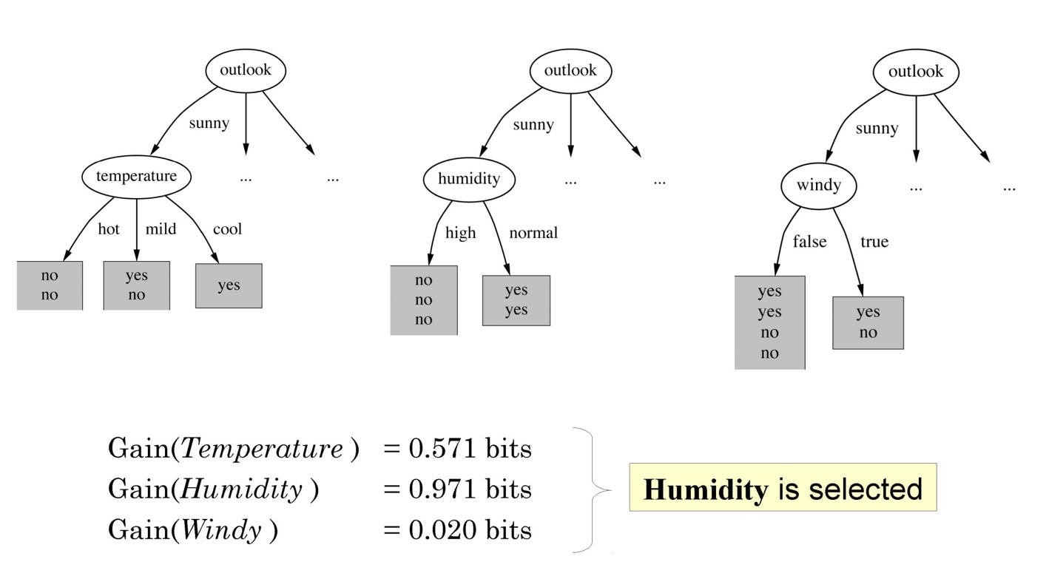
Example
InformationGain(temperature) = 0.571
InformationGain(humidity) = 0.971
InformationGain(windy) = 0.020
→ select humidity as root node of subtree for S_{i} (outlook = sunny)

Slide 24
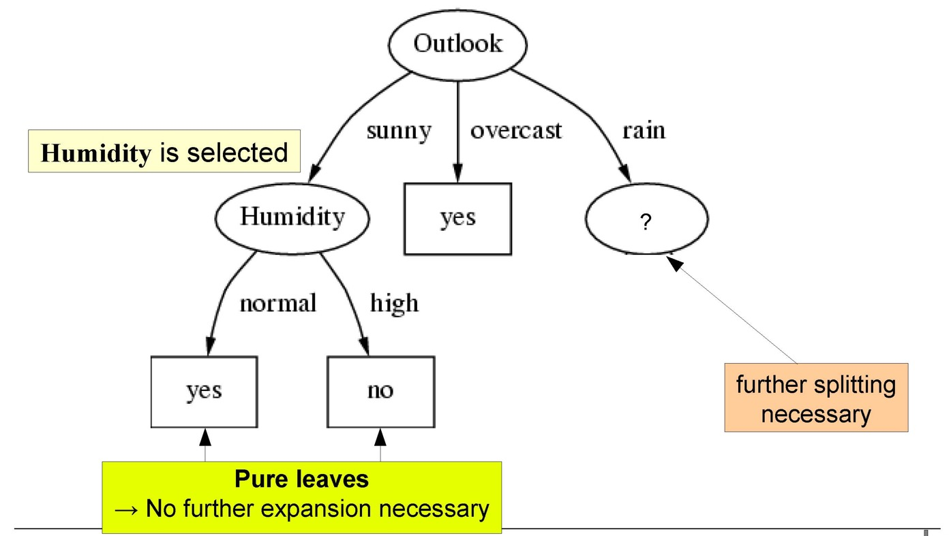
Example
Humidity is selected as root node (based on information gain)
Start recursion
All examples in S’ belong to one class → add leaf node

Slide 25
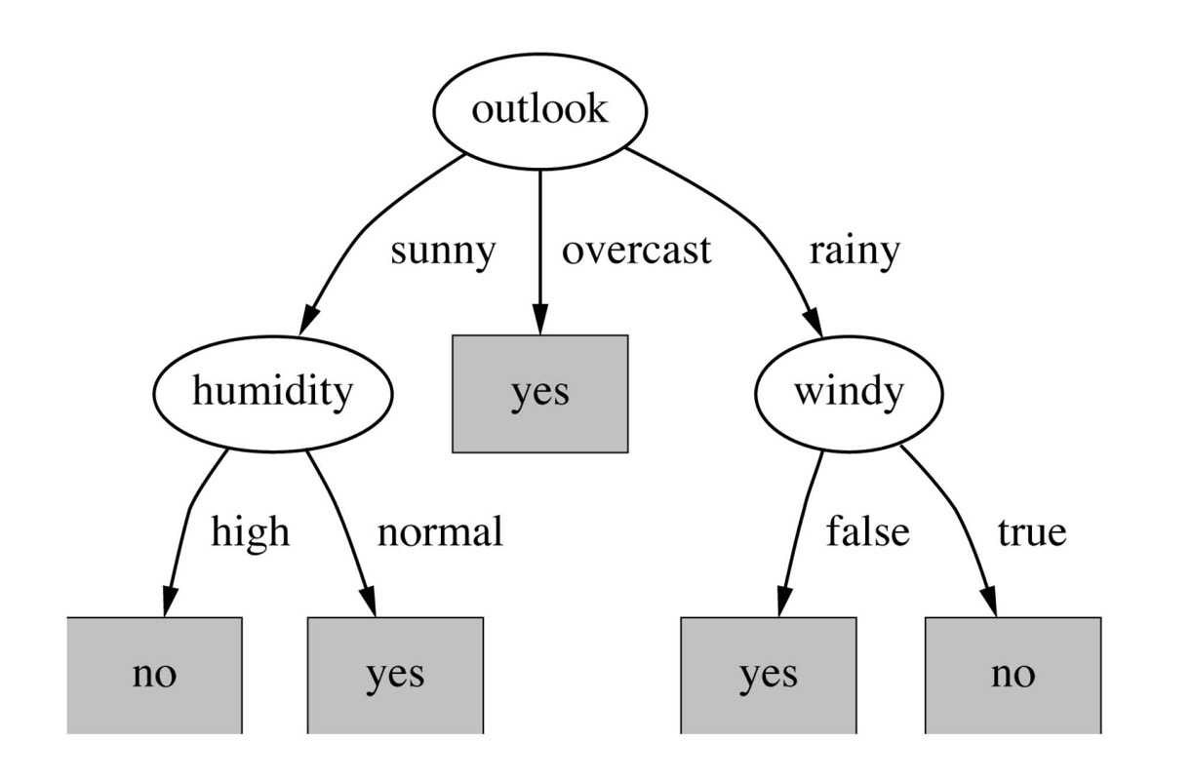
Final decision tree

Slide 26
Overfitting and pruning
The smaller the complexity of a concept, the less it overfits the data
a polynomial of degree n can always fit n+1 points
Thus, learning algorithms try to keep the learned concepts simple
note a “perfect” fit on the training data can always be found for a decision tree! (except when data is contradictory)
Pre-pruning
stop growing a branch when information becomes unreliable
Post-pruning
grow a decision tree that correctly classifies all training data
simplify it later by replacing some nodes with leaves
Post-pruning preferred in practice, because pre-pruning can “stop early”

Slide 27
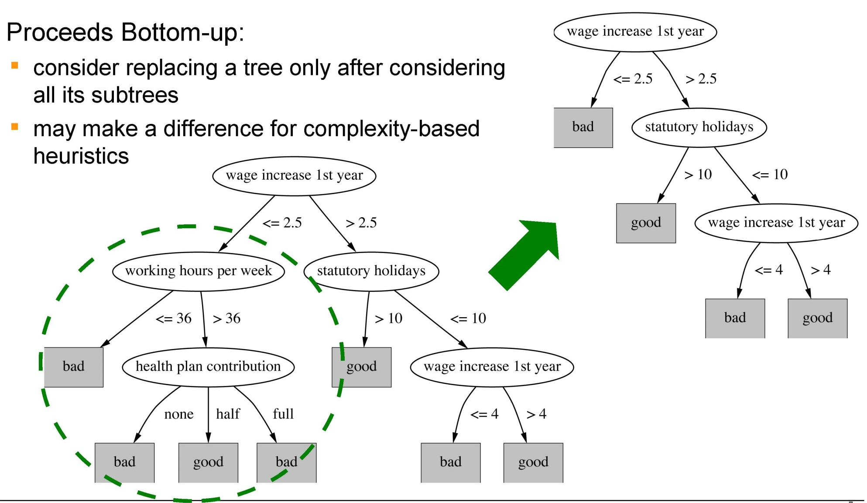
Sub-tree replacement

Slide 28
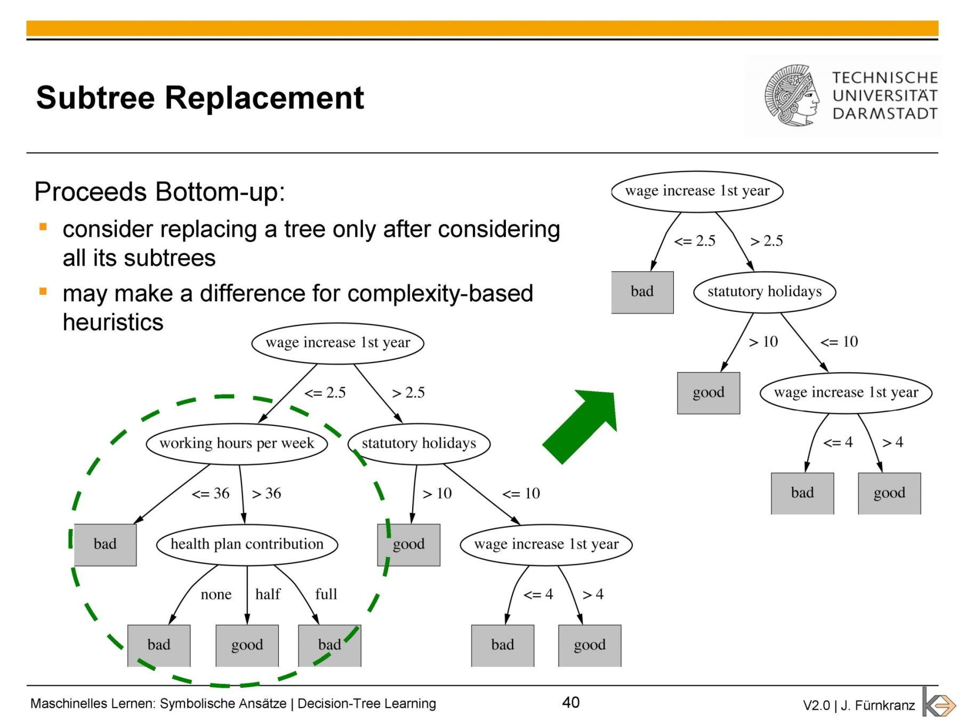

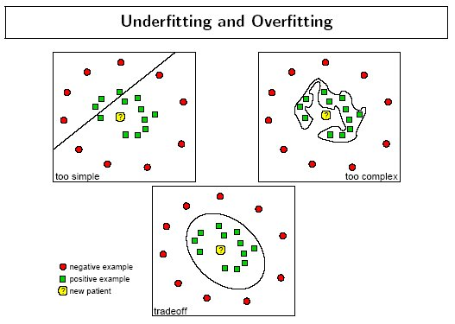
Sub-tree replacement
Overfitted
Pruned

Slide 29
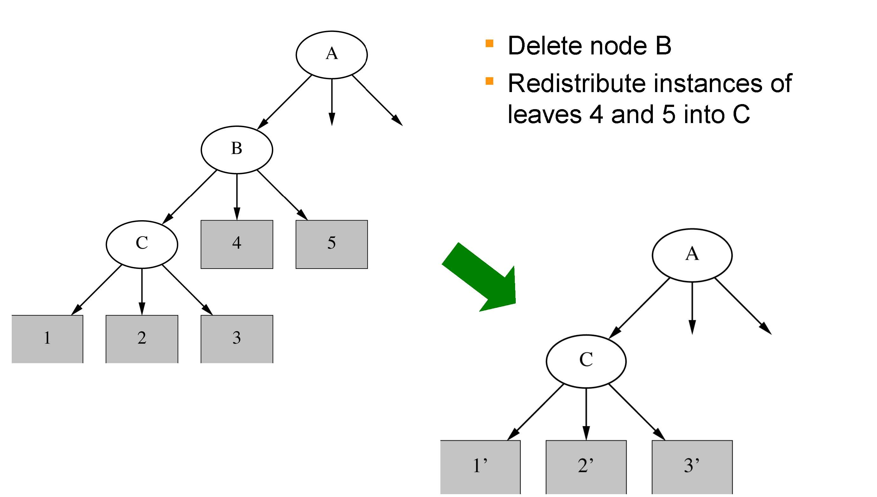
Sub-tree raising

Slide 30
Decision Trees
Advantages
efficient to create (training is fast)
simple to interpret → liked by users, explicit knowledge: white box model
useful to learn models for data which can be hierarchically categorized
Problems
overfitting is a serious problem (idiosyncrasies in the data set)
simpler, seemingly less accurate trees are often preferable → pruning
amount of training data in lower nodes is quite small
because it is split at every decision node
forces features to be checked in a specific order, even if features are independent of each other

Slide 31
Last week: Machine learning workflow
Define the problem and your hypothesis
Obtain data, split into train, dev, and test
Analyze the training data
Engineer features for your hypothesis
Select a machine learning algorithm for the task, set hyperparameters.
Train, evaluate on dev set, adjust
Test the model on the held-out data, visualize the results
Perform an error analysis, evaluate your hypothesis
Notes:
Missing here: Recap Linear regression, Decision Trees

Slide 32
k-nearest neighbor
(KNN)
KNN
Naïve Bayes
SVMs
Notes:
Beispiel für Business Analytics Studenten

Slide 33
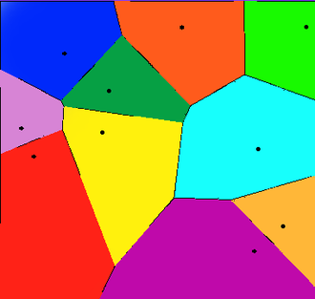
Nearest neighbor prediction
Simply predict the class of the nearest neighbor of the unseen instance in the representation space.
Voronoi Diagram: nearest neighbor in 2-dimensional space
example: 10 training instances
colored area: neighbor region of each training instance
determine color for test instance
assign class of training stance
How do we determine “nearness”?
Notes:
This is a bit similar to the prototype theory?

Slide 34
Similarity
Nearness in feature space = similarity between represented concepts
Assumption: concepts that have similar values in many dimensions (= features) are similar.
How do we measure similarity? By measuring the distance between two vectors in the feature space.

Slide 35
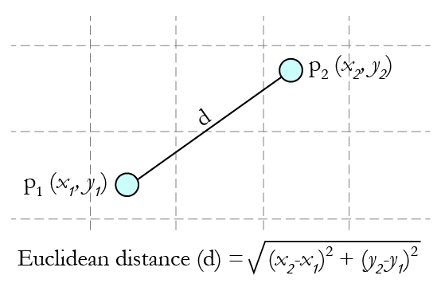
Euclidean distance
Straight line distance between two vectors
In 2-dimensional space → Pythagoras
In n-dimensional space: $d\left(x,y\right)= \sqrt{\sum_{i=1}^{n}{{(x_{i}−y_{i})}^{2}}}$
also known as L₂-norm: ${\left\|x−y\right\|}_{2}$
https://www.analyticsvidhya.com/blog/2015/08/learning-concept-knn-algorithms-programming/
Notes:
Entspricht Luftlinie = straight line distance
Im Buch kamen noch Gewichte dazu.

Slide 36
Manhattan distance
Straight line is often not possible
Step-wise distance between two points: sum of the absolute differences of their Cartesian coordinates.
$d\left(x,y\right)=\sum_{i=1}^{n}{\left|x_{i}−y_{i}\right|}$
also known as L₁-norm: ${\left\|x−y\right\|}_{1}$
red, blue, yellow: Manhattan distance
green: Euclidean distance
Notes:
rot,blau, gelb ist alles gleich lang
grün ist kürzer

Slide 37
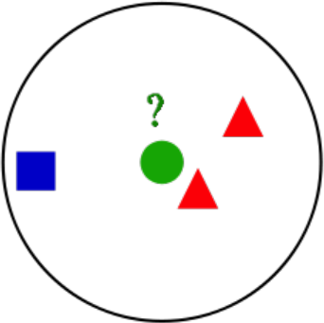


k-nearest neighbor classification
Assign majority class of the k-nearest neighbors.
No training!
Just store all instances → might build special lookup data-structure to optimize comparison
k is a hyperparameter
Also known as Collaborative Filtering or Instance-based Learning.
k=3
=2 =1 →

Slide 38

Choice of k
3-nearest neighbors vs. 5-nearest neighbors prediction
=2 =3 →
https://en.wikipedia.org/wiki/K-nearest_neighbors_algorithm#/media/File:KnnClassification.svg
Notes:
Cross-validation for finding good k’s

Slide 39
Nearest neighbor search
Given: a set P of n points in R^{d} , a test instance q
Goal: find the nearest neighbor p of q in P
Naïve approach: compute the distance from the query point to every other point in the database, keeping track of the “best so far”
The naïve approach is very expensive, if you have many instances.
n comparisons for each test instance.
Apply more efficient search algorithms.
p
q

Slide 40
Properties of kNN algorithm
Inductive bias
similar classification of nearby instances
similar to human heuristics
Curse of dimensionality
similarity metric might be misled by irrelevant attributes
Notes:
Wenn man mehr Dimensionen nimmt, führt das ggf. Dazu dass alle Punkte gleich weit von einander entfernt sind

Slide 41
Naïve Bayes
KNN
Naïve Bayes
SVMs
Notes:
Beispiel für Business Analytics Studenten

Slide 42
Probabilistic classifier
Calculate a probability distribution over all classes (not only a single class)
More realistic setting for many tasks → model uncertainty
http://vis.stanford.edu/papers/termite

Slide 43



Example task: Document classification
We have a training corpus with documents from 3 different categories:
Automotive Sports Murder Mystery

Slide 44



Feature representation: words in the document
Some words are prototypical for a category. Each occurrence of a word in a document is an indicator for the category.
Word frequency
Word frequency
Word frequency

Slide 45



Prior probability
How likely is a category?
→ Frequency of each category in the training data
Assumption: The training data is representative.
→ We expect that about half of the documents in the test data belong to the automotive category.
50%
30%
20%
Prior probability

Slide 46




Likelihood = Prior prob * feature contribution
50%
*
run
*
fast
*
…
= Likelihood for automotive
30%
*
run
*
fast
*
…
= Likelihood for sport
20%
*
run
*
*
= Likelihood for mystery thriller
fast
…

Slide 47
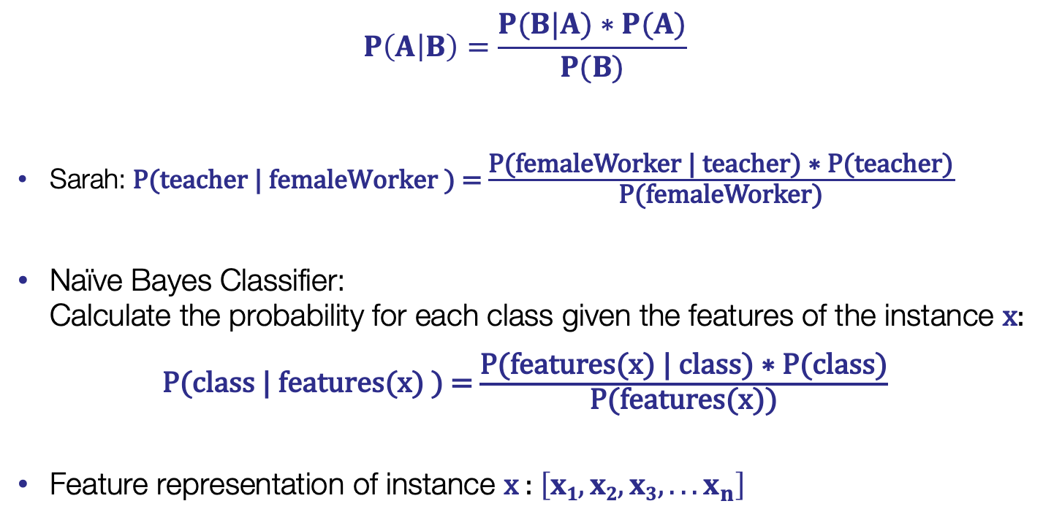
Recall: Bayes’ Rule
$$P\left(A | B\right)=\frac{P(B|A)∗P(A)}{P(B)}$$
Sarah: P(teacher | femaleWorker ) =$\frac{\text{P}\text{(}\text{femaleWorker} \text{|} \text{teacher}\text{) ∗ }\text{P}\text{(}\text{teacher}\text{)}}{\text{P}\text{(}\text{femaleWorker}\text{)}}$
Naïve Bayes Classifier: Calculate the probability for each class given the features of the instance $\text{x}$:
P(class | features(x) ) =$\frac{\text{P}\text{(}\text{features}\text{(}\text{x}\text{) }\text{|} \text{class}\text{) ∗ }\text{P}\text{(}\text{class}\text{)}}{\text{P}\text{(}\text{fe}\text{atures}\text{(}\text{x}\text{)}\text{)}}$
Feature representation of instance $\text{x}$: $\left[x1,x2,x3,...x_{n}\right]$

Slide 48
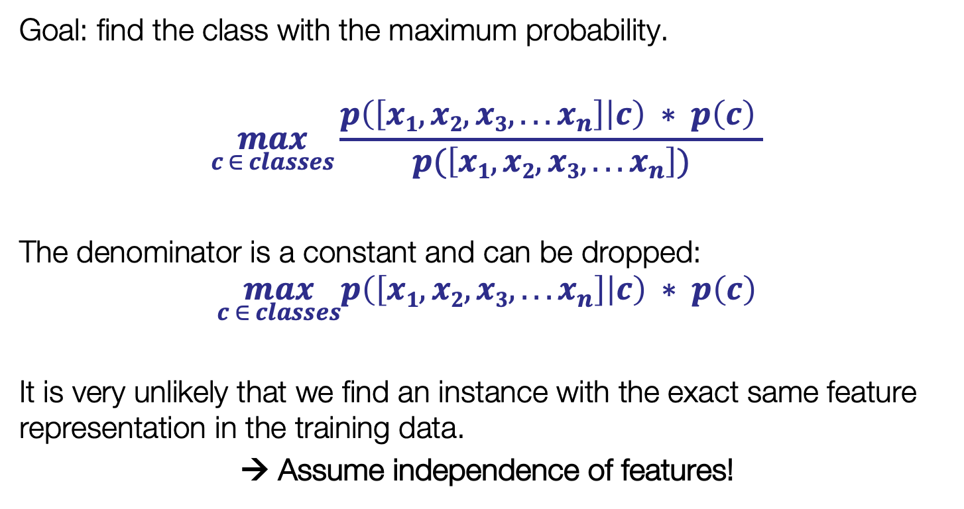
Naïve Bayes classifier
Goal: find the class with the maximum probability.
$$\max_{c ∈ classes}\frac{p\left(\left[x1,x2,x3,...x_{n}\right] | c\right) ∗ p\left(c\right) }{p(\left[x1,x2,x3,...x_{n}\right])}$$
The denominator is a constant and can be dropped:
$$\max_{c ∈ classes}p\left(\left[x1,x2,x3,...x_{n}\right] | c\right) ∗ p\left(c\right)$$
It is very unlikely that we find an instance with the exact same feature representation in the training data.
→ Assume independence of features!
Notes:
Zähler hat keinen Einfluss auf das Maximum, weil er immer gleich ist.
Prior probability wird im “echten Leben” häufig vernachlässigt: base rate neglect!
Notation: oft sieht man Naive Bayes auch umgekehrt: Prior zuerst

Slide 49
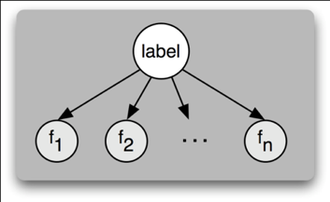
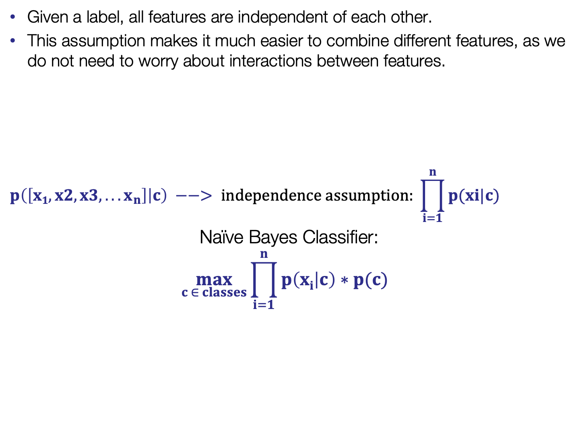
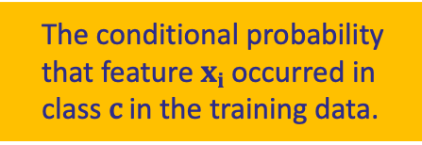
Independence assumption
Given a label, all features are independent of each other.
This assumption makes it much easier to combine different features, as we do not need to worry about interactions between features.
$$p\left(\left[x1,x2,x3,...x_{n}\right] | c\right) −−> independence assumption: \prod_{i=1}^{n}{p(xi|c)}$$
Naïve Bayes Classifier: $$\max_{c ∈ classes}\prod_{i=1}^{n}{p\left(xi | c\right)∗p(c) }$$
The conditional probability that feature $xi$ occurred in class c in the training data.

Slide 50
The naïvety of independence
It’s unreasonable to assume that all features are independent.
If football occurs, it’s more likely that goal also occurs in the same text.
What happens if we ignore this dependence?
Possibility of double-counting highly correlated features
football and goal are highly correlated, but assumed independent, so each feature is counted separately in the training corpus
This pushes the classifier closer to a given label than justified.
→ Correlated features are problematic for Naïve Bayes classifiers.

Slide 51
Another example: Play golf?
outlook |  |  | temperature |  |  | humidity |  |  | windy |  |  | play
 | yes | no |  | yes | no |  | yes | no |  | yes | no | yes | no
sunny | 2 | 3 | hot | 2 | 2 | high | 3 | 4 | false | 6 | 2 | 9 | 5
overcast | 4 | 0 | mild | 4 | 2 | normal | 6 | 1 | true | 3 | 3
rainy | 3 | 2 | cool | 3 | 1
x = [sunny, cool, high, true] , y = ?play?
Naïve Bayes Classifier:
yes: $\prod_{i=1}^{n}{p\left(features | yes\right) ∗ P\left(yes\right)}= \frac{2}{9}∗\frac{3}{9}∗\frac{3}{9}∗\frac{3}{9}∗\frac{9}{14}=0.0053$
no: $\prod_{i=1}^{n}{p\left(features | no\right) ∗ P\left(no\right)}= \frac{3}{5}∗\frac{1}{5}∗\frac{4}{5}∗\frac{3}{5}∗\frac{5}{14}=0.0206$
→ Classifier says no.
Notes:
Numbers cannot be interpreted – relative difference is all that counts
Confidence in decision is higher if the difference is higher

Slide 52
Naïve Bayes: Summary
Probabilistic learning method which uses knowledge about the prior probabilities of classes and about the conditional probability of features occurring in a particular class.
Useful in many practical applications
Training is very fast.
Binary, numeric and nominal features can be mixed.
If the independence assumption is violated too much, the classifier fails.
Identical or highly correlated features are problematic.
→ Can be addressed with feature selection algorithms

Slide 53
Support Vector Machines
KNN
Naïve Bayes
SVMs

Slide 54
How to split a feature space into 2 classes?
1-dimensional ( = 1 feature)
By a point: if feature x >= 0.7 then class 1 else class 2
2-dimensional ( = 2 features)
By a line: w x $−b$
3-dimensional ( = 3 features)
By a plane: w₁ x₁ +w₂ x₂$−b$
n-dimensional ( = n features)
By a hyperplane: $\vec{w} ∙ \vec{x}−b$
A hyperplane in R^{n}is a n-1 dimensional subspace of R^{n}.
?

Slide 55
Linear separation
How would you classify these data points?

Slide 56
Linear separation
How would you classify these data points?

Slide 57
Linear separation
How would you classify these data points?

Slide 58
Linear separation
Any of these lines would be fine. How do we find the best?

Slide 59
Linear separation
Avoid misclassification

Slide 60
Classifier margin
Margin of a linear classifier: the width by which the boundary could be increased before hitting a datapoint

Slide 61
Support vectors
Goal: Find the linear classifier with the maximum margin.
Support vectors: datapoints which are touched by the margin.
→ simplest form of support vector machines (SVM).

Slide 62
Formally
$\vec{w} ∙ \vec{x}−b=0$defines a hyperplane, w is the normal vector of the hyperplane
left boundary: $\vec{w} ∙ \vec{x}−b=1$
right boundary: $\vec{w} ∙ \vec{x}−b=−1$
maximize the margin = the distance between left and right boundary = $\frac{2}{\left\|\vec{w}\right\|}$ →minimize $\vec{w}$
determine the best $\vec{w}$ and $b$ , such that for all points ${\vec{x}}_{i}$ it holds that
$\vec{w} {∙ \vec{x}}_{i}−b ≥1 , if y_{i}=class 1$
$\vec{w} {∙ \vec{x}}_{i}−b ≤−1 , if y_{i}=class 2$
https://en.wikipedia.org/wiki/Support_vector_machine#/media/File:Svm_max_sep_hyperplane_with_margin.png
Notes:
den margin maximieren, so dass alle Punkte von Klasse 1 links davon liegen und alle Punkte von Klasse 2 rechts davon
f(x,w,b) = sign(w x + b)

Slide 63
Maximum margin
Maximizing the margin is an intuitive approach.
Consequence: only support vectors (the borderline cases) are important; other training examples are ignorable.
Empirically it often works very well.
Notes:
Zeigen: Wenn wir die anderen Punkte bewegen, ändert sich die optimale Hyperplane nicht.

Slide 64
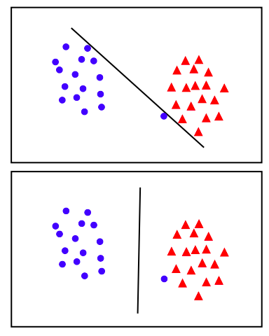
Handling Noise
Which solution is better?
Hard Margin: All data points should be classified correctly → No training error
What if the training set is noisy?
http://www.robots.ox.ac.uk/~az/lectures/ml/lect2.pdf

Slide 65
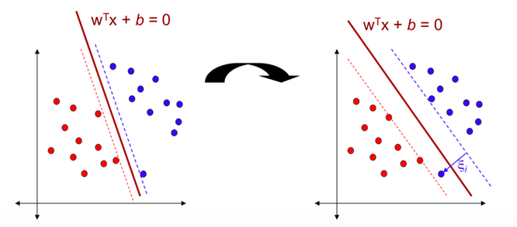
Cut me some slack!
Soft margin classification:
Slack variables ξ_{i} allow misclassification of difficult or noisy examples.
→ A trade-off between the margin size and the number of mistakes on the training data.
Notes:
ξ = Xi
slack: nachsichtig, nachlässig

Slide 66
Non-linear SVMs
Datasets that are linearly separable with some noise work out great:
But what are we going to do if the dataset is just too hard?
How about… mapping data to a higher-dimensional space:
0
x
0
x
x²
Φ: x → (x, x²)
0
x
Notes:
add φ((x,)) = (x, x² )

Slide 67
Non-linear SVMs
Idea: the original input space can be mapped to some higher-dimensional feature space where the training set is separable.
Φ: x → φ(x)
(x,y) → (x, y, x²+y²)

Slide 68
Multi-class classification with SVMs
SVMs can only separate two classes. What if we have more than two?
One vs. all: with m classes, learn m SVMs
SVM 1 learns “Output==1” vs “Output != 1”
SVM 2 learns “Output==2” vs “Output != 2”
...
SVM m learns “Output==m” vs “Output != m”
→use prediction with largest distance to the decision plane
One vs. one: train $\frac{m ∗ (m−1)}{2}$“one vs. one” classifiers
SVM 1 learns “Output==1” vs “Output == 2”
SVM 2 learns “Output==1” vs “Output == 3”
...
→ choose the class that is predicted most often
Expensive, but often remarkably fast as one vs. one decision might be easier and uses less instances.

Slide 69
SVM advantages and limitations
Advantages
deals well with high-dimensional, sparse vectors
very flexible: different kernel functions, number of support vectors
robust classifiers, noise-tolerant
overfitting can be controlled by soft margin approach
Limitations
only two classes: must use 1 vs. all or other schemes for multiclass problems
high computational complexity
but efficient implementations available
choice of kernel function and its parameters is a trial-and-error enterprise
black box

Slide 70
Summary
KNN, linear regression and decision trees
are easy to understand and produce interpretable output.
struggle with high-dimensional input.
are prone to overfitting.
Naïve Bayes
is a fast and often effective algorithm.
can deal with mixed feature types.
struggles with correlated features (independence assumption).
SVMs
can deal with high-dimensional feature spaces.
have many parameters to tune.

Slide 71
Reading
Mandatory
https://monkeylearn.com/blog/introduction-to-support-vector-machines-svm/ → advertised as a “7 min read” ☺
Please answer the following question in Moodle: In your own words: What is the kernel trick?
Optional
any good machine learning introduction

